Slide 1
Beyond Childhood: The Hidden Presence of ADHD in Adults
Healthcare data analysis

Slide 2
Report Content
Introduction
Data Selection
Data Preprocess
Model Selection
Analysis
Conclusion

Slide 3
Introduction
Attention-Deficit/Hyperactivity Disorder (ADHD) was traditionally considered a childhood condition, but over the years, there has been an increasing recognition of its prevalence and impact on adults.
While the symptoms of ADHD often manifest during childhood, a significant number of individuals continue to experience these challenges into adulthood. The prevalence of ADHD in adults is estimated to be around 2.5% to 5%, though it's worth noting that many cases may go undiagnosed.

Slide 4
Factors and Causes
Genetic Factors:
ADHD tends to run in families, suggesting a genetic component. Individuals with a family history of ADHD are more likely to develop the condition.
Neurological Factors:
Differences in brain structure and function may contribute to ADHD. The areas of the brain involved in attention, impulse control, and executive functions may function differently in individuals with ADHD.
Brain Chemistry:
Neurotransmitters, such as dopamine and norepinephrine, play a role in regulating attention and impulse control. Imbalances in these neurotransmitters are thought to be associated with ADHD.
Prenatal and Birth Factors:
Certain prenatal and perinatal factors, such as exposure to tobacco smoke, alcohol, or drugs during pregnancy, premature birth, low birth weight, and complications during delivery, have been studied as potential risk factors.
Environmental Factors:
Childhood exposure to environmental toxins, lead, and other environmental factors may contribute to ADHD risk.
Traumatic Brain Injury (TBI):
A history of traumatic brain injury, especially during early childhood, has been linked to an increased risk of developing ADHD.
Maternal Smoking and Substance Abuse:
Smoking during pregnancy and maternal substance abuse have been associated with an elevated risk of ADHD in offspring.
Nutritional Factors:
Some studies suggest that certain nutritional factors, such as deficiencies in omega-3 fatty acids and iron, may be linked to ADHD.

Slide 5
Introduction: Motivation of the study
Identification and Diagnosis: Understanding the prevalence of Adult ADHD helps in improving the identification and diagnosis of individuals who may be affected.
Treatment Planning: Research on the prevalence of Adult ADHD contributes to the development of effective treatment plans.
Impact on Quality of Life: Adult ADHD can have a significant impact on various aspects of life, including relationships, education, employment, and mental health.
Public Health Impact: Recognizing the prevalence of Adult ADHD has broader public health implications. It enables policymakers and healthcare systems to allocate resources effectively, plan public health campaigns, and implement preventive measures.
Educational and Workplace Accommodations: Research on prevalence informs the development of strategies for educational institutions and workplaces to accommodate individuals with ADHD.
Reducing Stigma: A deeper understanding of the prevalence of Adult ADHD can contribute to reducing the stigma associated with the disorder.

Slide 6
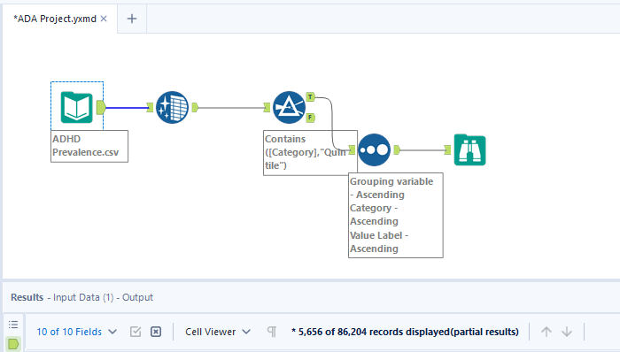
Data Selection
Dataset was gotten from figures.nz
Features:
Year
Indicator
Gender
Grouping Variable
Category
Estimate
Value
Value Unit
Value Label

Slide 7
Data Pre-process
For the data preprocess, I used different machine learning and data analysis tools for the preprocess of the data.
Alteryx
Rapidminer
Data Cleansing
Data Sorting
Analysis
Conclusion
Data Import
Model Selection
Data visualization

Slide 8
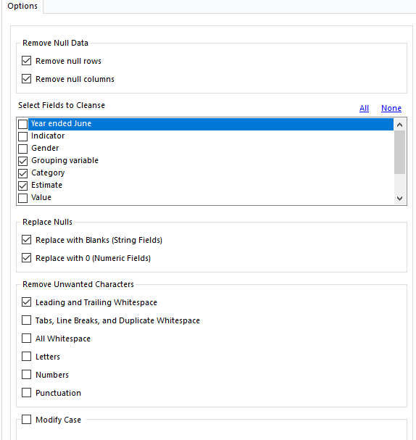
Data Pre-process
Alteryx – Data cleansing tool
The data contains unnecessary values and requires a proper cleaning and normalization. It also contains null values that are needed to be removed.
The data contained over 80,000+ data, after the preprocessing it showed 33,000+ data eliminating irrelevant variables from category, gender, and grouping variable.

Slide 9
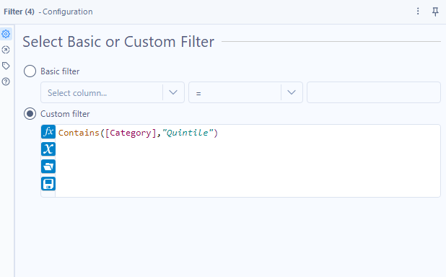
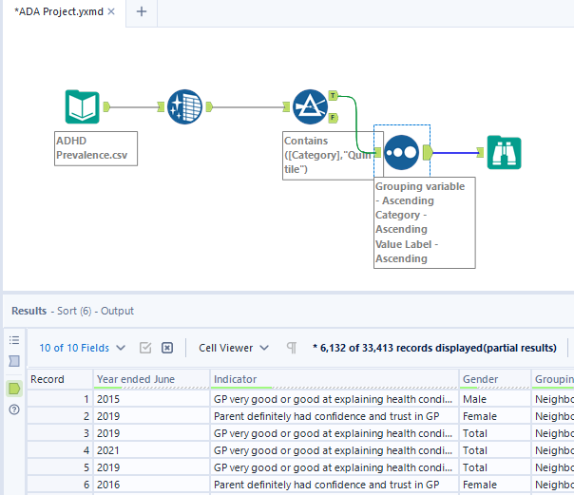
Data Pre-process

Slide 10
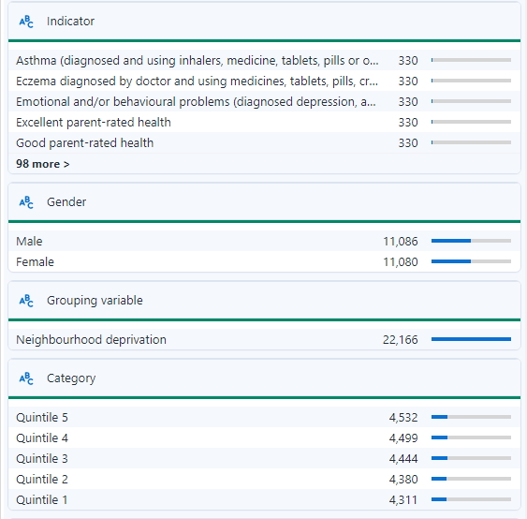
Model Selection
I used the concept of CRISP-DM for the methodology of my research.
The CRoss Industry Standard Process for Data Mining

Slide 11
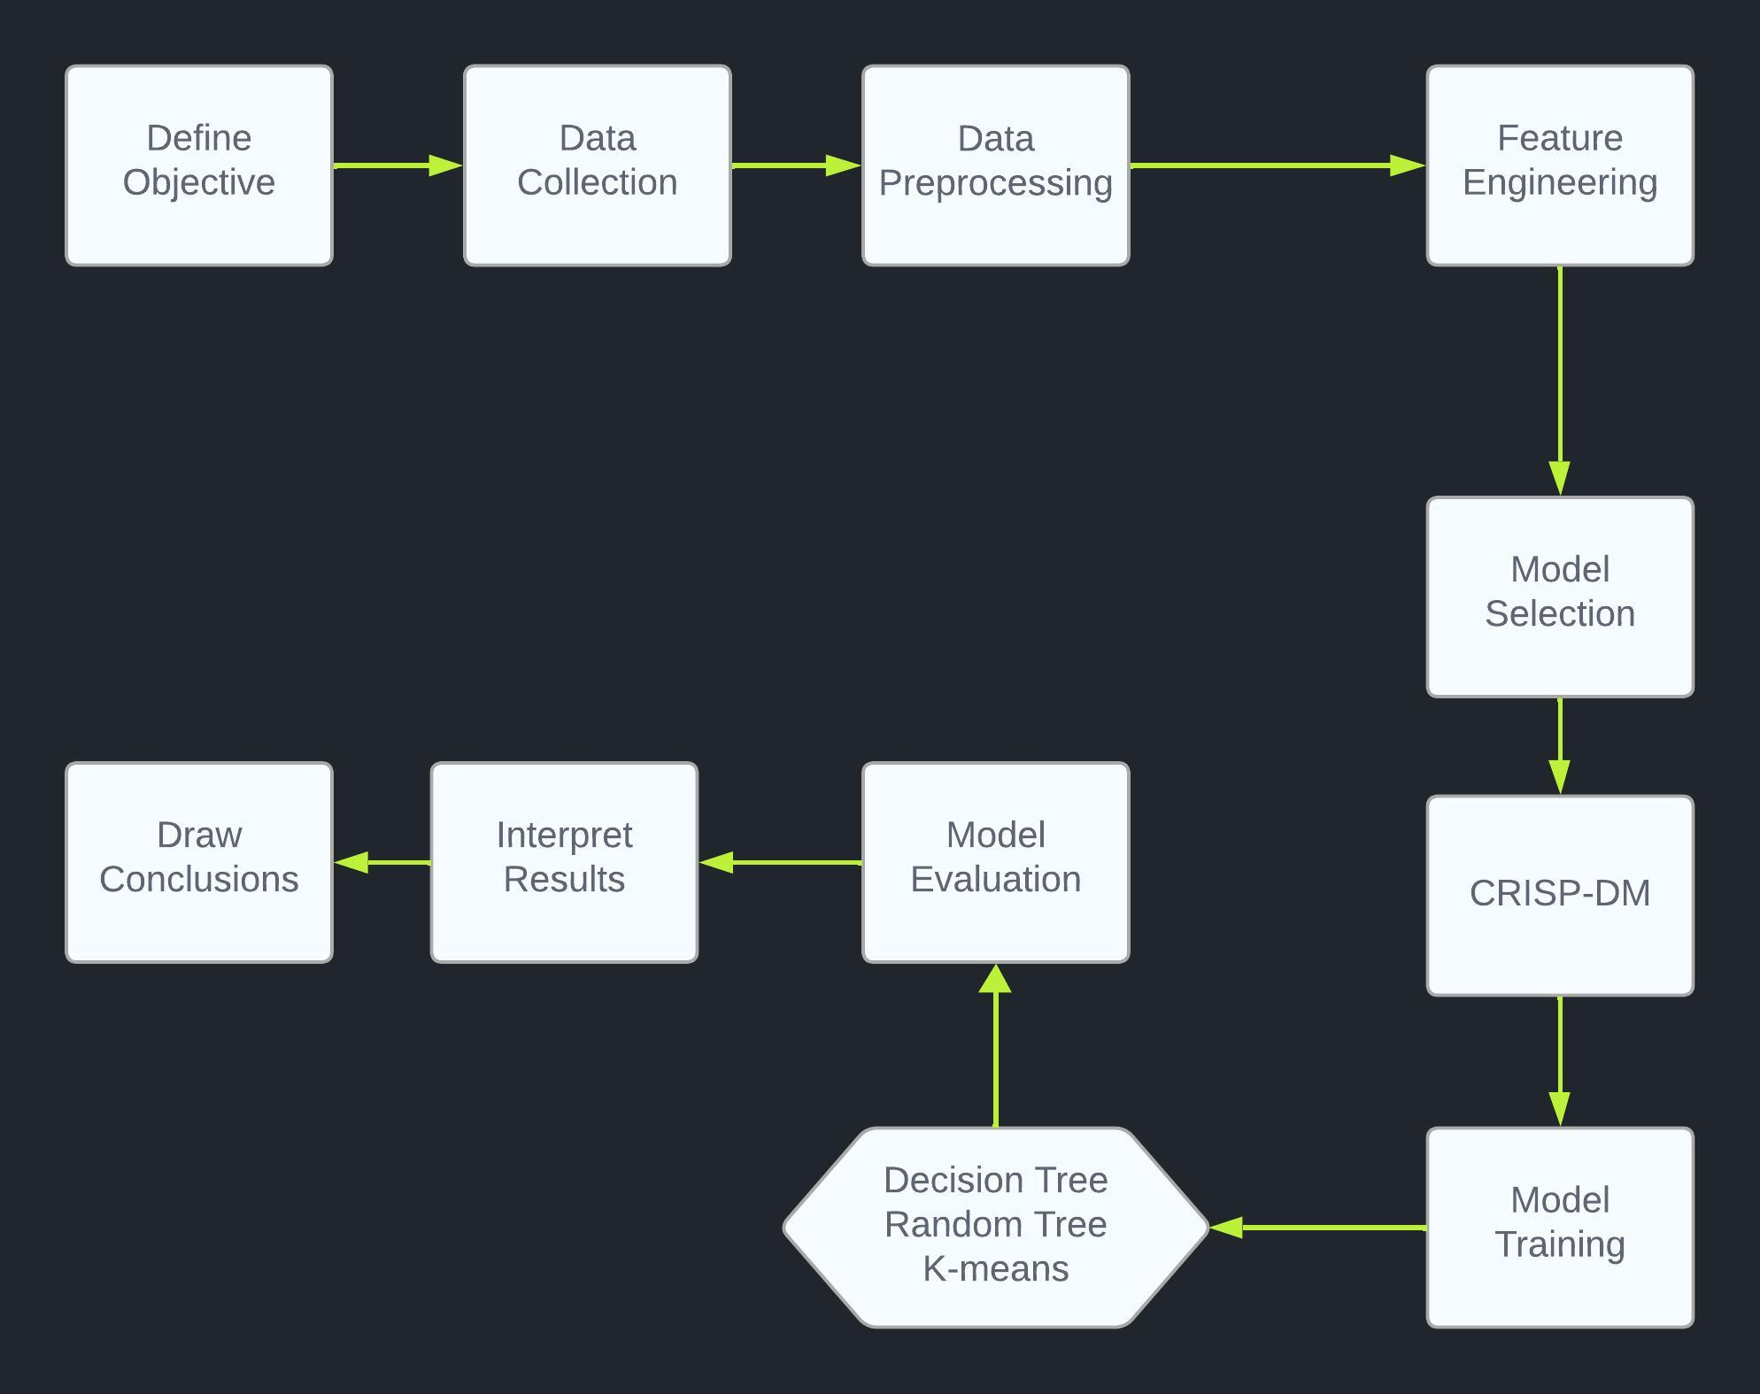
Model Selection
Decision flowchart and multiple model selection

Slide 12
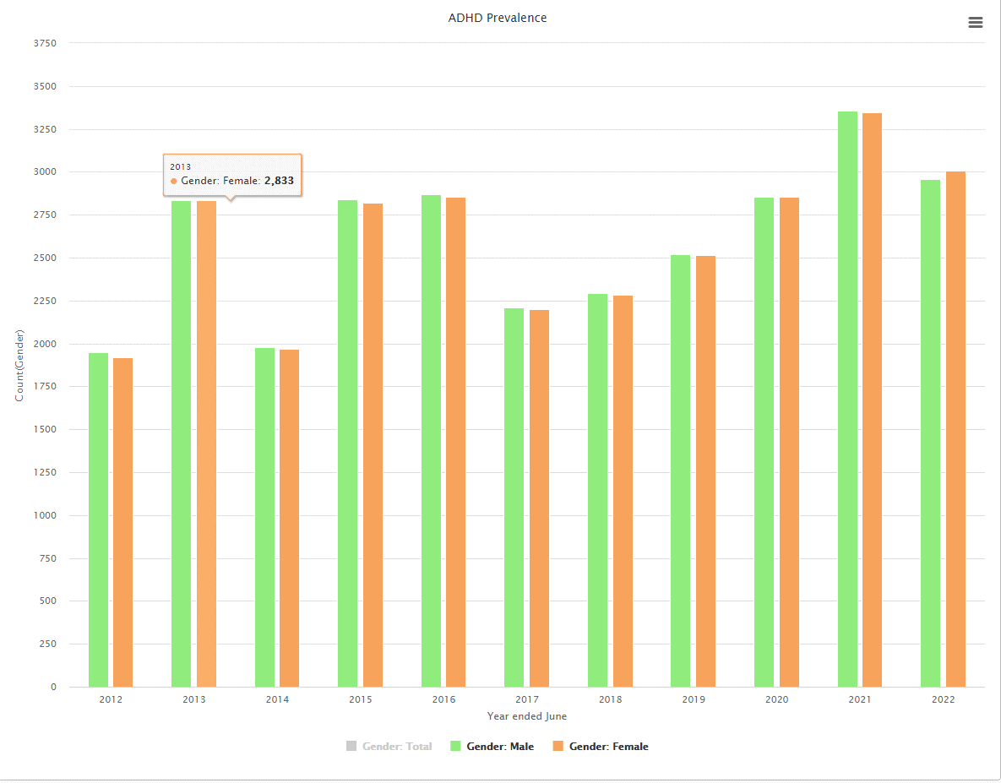
Analysis & Evaluation
The data shows the amount of people that are affected from this disorder.
This data has been categorized based on the year in correlation with the gender.

Slide 13
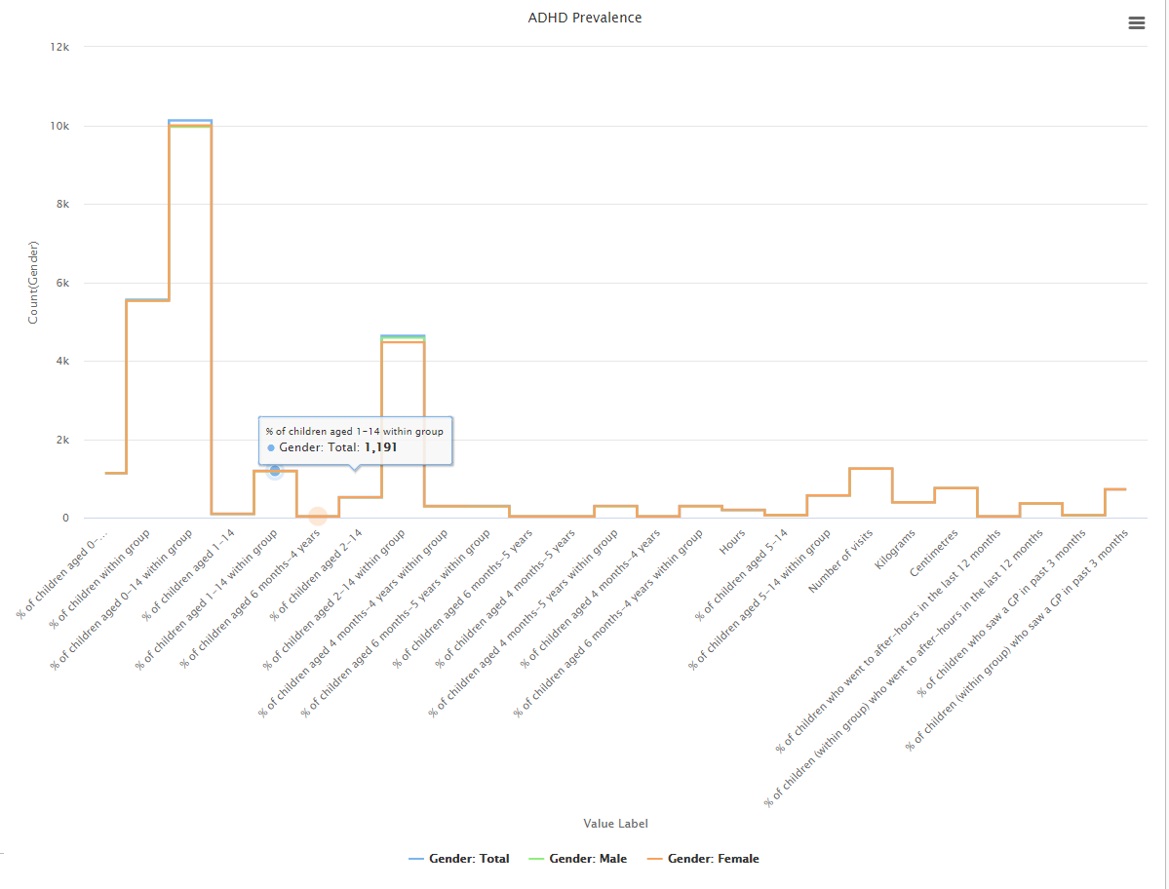
Analysis & Evaluation
Based on the result it showed a large number of percentage that were affected by ADHD from 0-14 years old.
The higher prevalence of ADHD in children suggests that the disorder is often identified and diagnosed during the early stages of development.
The lower prevalence in adults may indicate that some individuals with ADHD may go undiagnosed or untreated into adulthood.

Slide 14
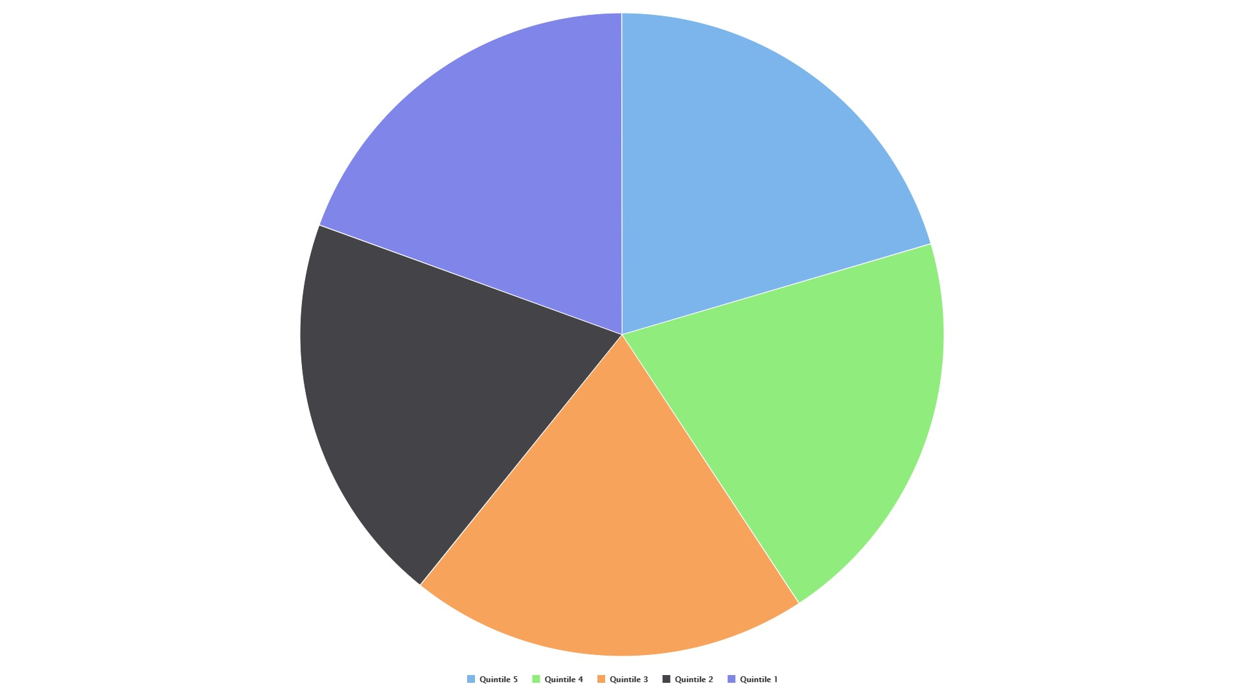
Analysis & Evaluation
This chart is group by category and valued based on Grouping variables.
Based on the data source it was suggested that the data has 95% confidence intervals. Features are provided based age group, gender, ethnic group. Quintile 1 represents the 20 percent of areas with the lowest levels of deprivation and quintile 5 represents the 20 percent of areas with the highest level of deprivation.

Slide 15
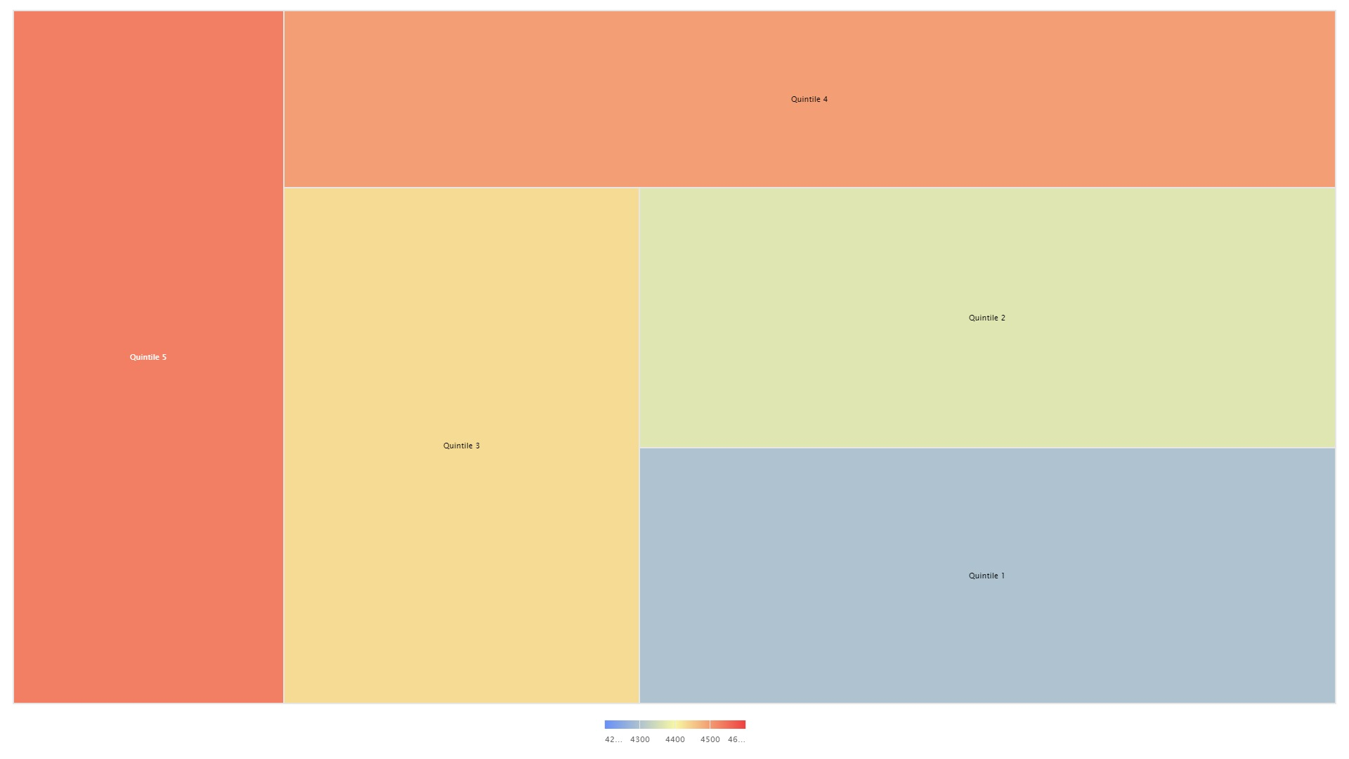

Slide 16
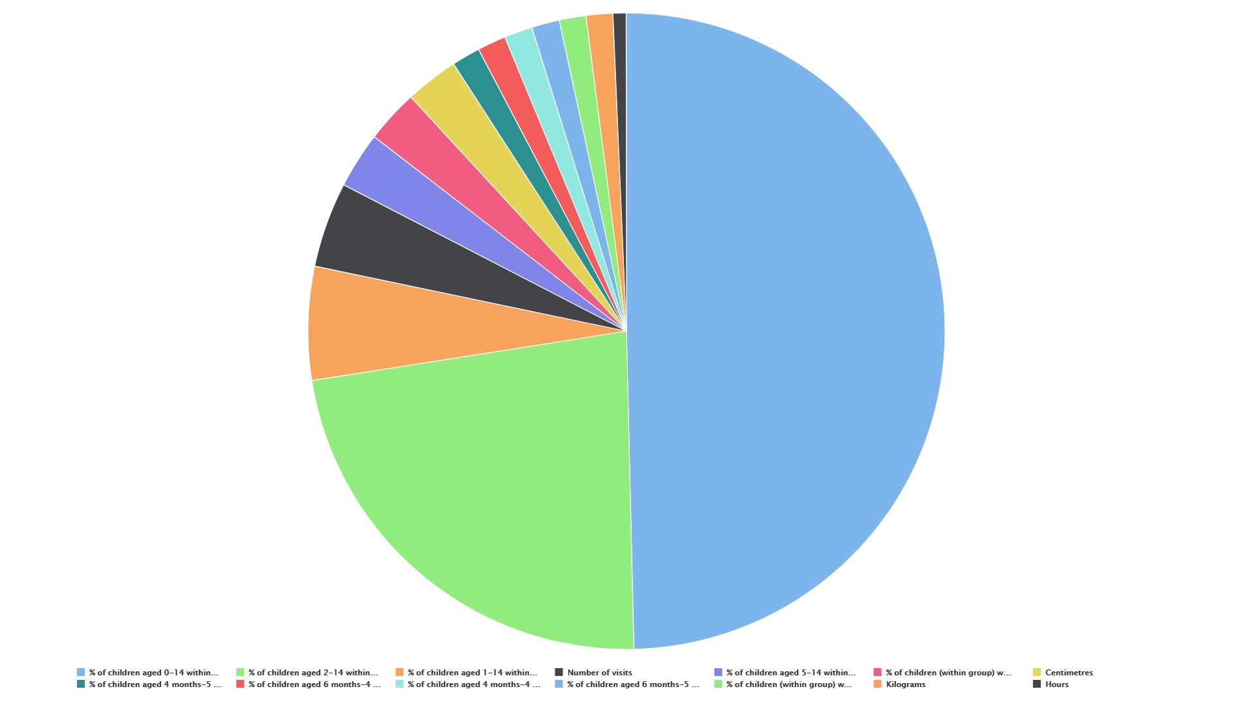
This chart shows correlation between the value label and the grouping variable.
It shows that most of the patients that have been diagnosed with ADHD have a large percentage of children aged from 0-14 within the group.

Slide 17
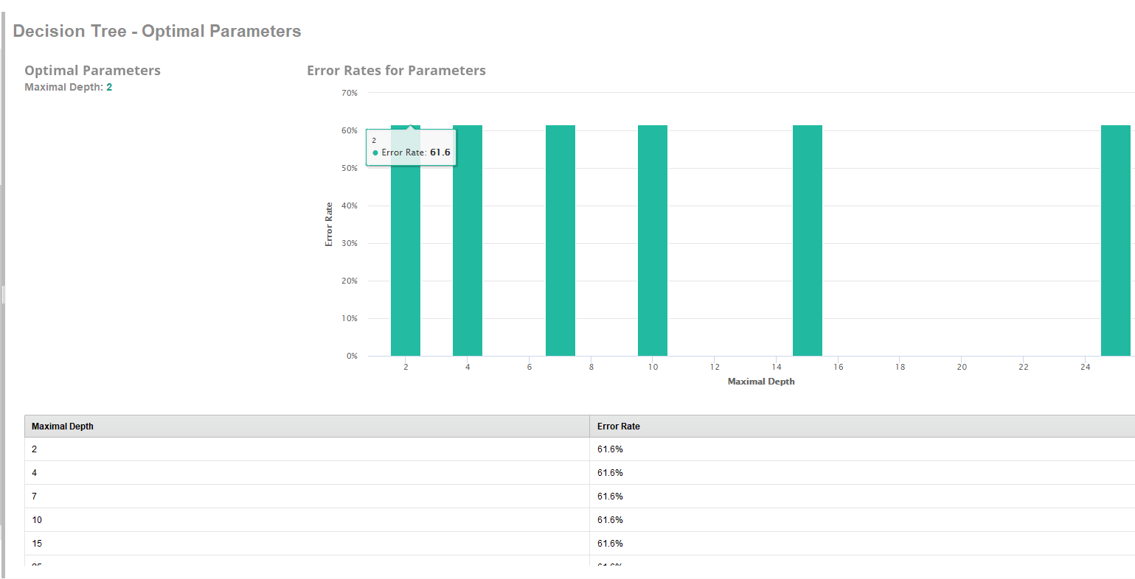

Slide 18
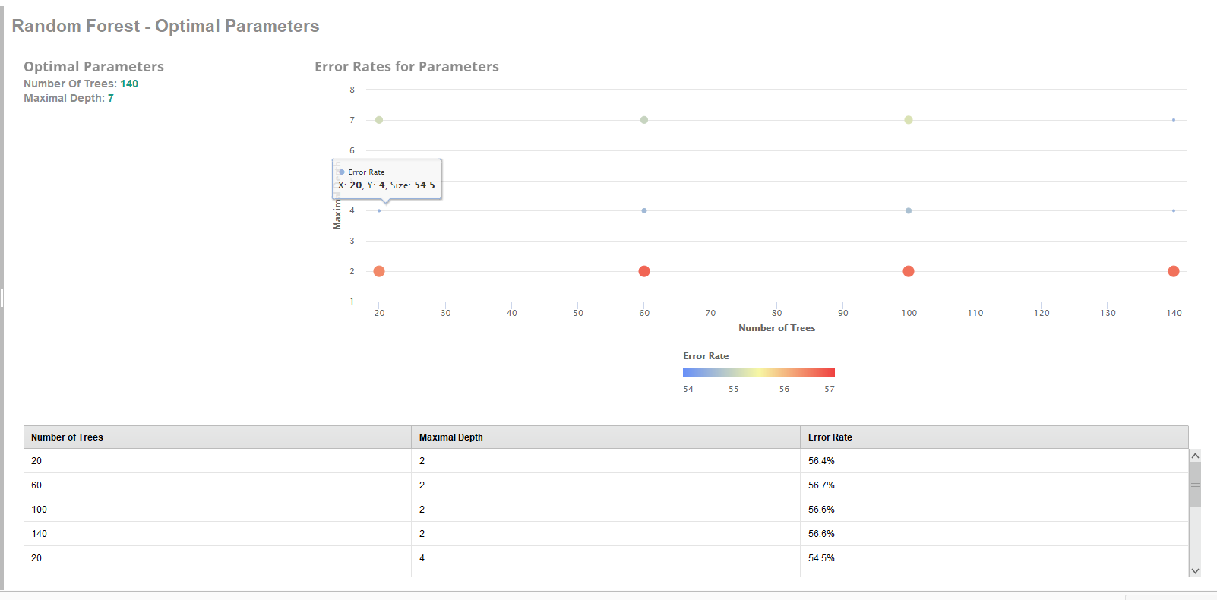

Slide 19

Conclusion
In conclusion, the research shows that ADHD is not just a childhood condition; it often persists into adulthood. Recognizing this prevalence is crucial for providing timely support and interventions. This understanding has significant implications for healthcare, education, and employment policies. Acknowledging adult ADHD helps reduce stigma, increase awareness, and improve tailored treatments. Overall, addressing ADHD in adults requires a comprehensive and informed approach for better quality of life.
https://neurogrow.com/add-vs-adhd-and-the-different-types-of-adhd/

